Slide 1
OPERATION LIFESAVER
A Partnership in Public-Rail Safety
OL Canada - A cost effective and modern approach to delivering its Public-Rail Safety message
“Let’s Save Lives” Conference
Dan Di Tota, National Director
Tallinn, Estonia - March 15, 2011

Slide 2
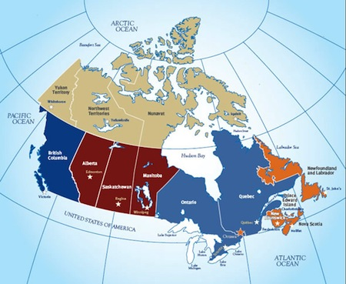
Canadian Facts
Population - 33,000,000
2nd largest country in the world
Close to 10,000,000 sq. km. in area
More than 5,000 km. coast to coast

Slide 3
Canadian Railway Facts
48,000 km. of track
20,000 public level crossings
And 20,000 private level crossings

Slide 4
Driver Behaviour

Slide 5
Pedestrian Behaviour

Slide 6
TSB* Statistics (Canada)
In 2010 there were 261 collisions involving trains and vehicles / pedestrians
Resulting in…
79 fatalities
47 serious injuries
* Transportation Safety Board
Notes:
Sense of the present problem in Canada

Slide 7
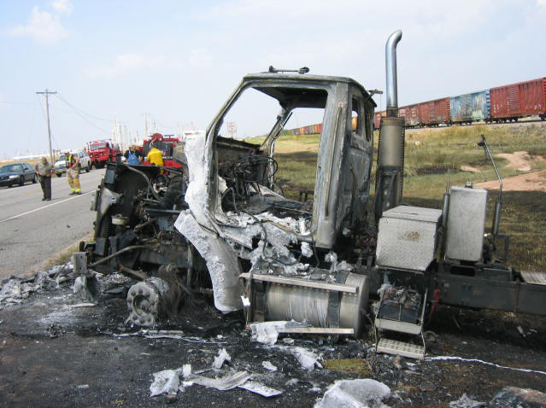
Devastating Consequences
Notes:
Although some may think the problem may be too small to give due consideration…

Slide 8
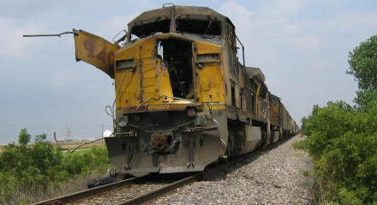
Devastating Consequences
Notes:
Although some may think the problem may be too small to give due consideration…

Slide 9
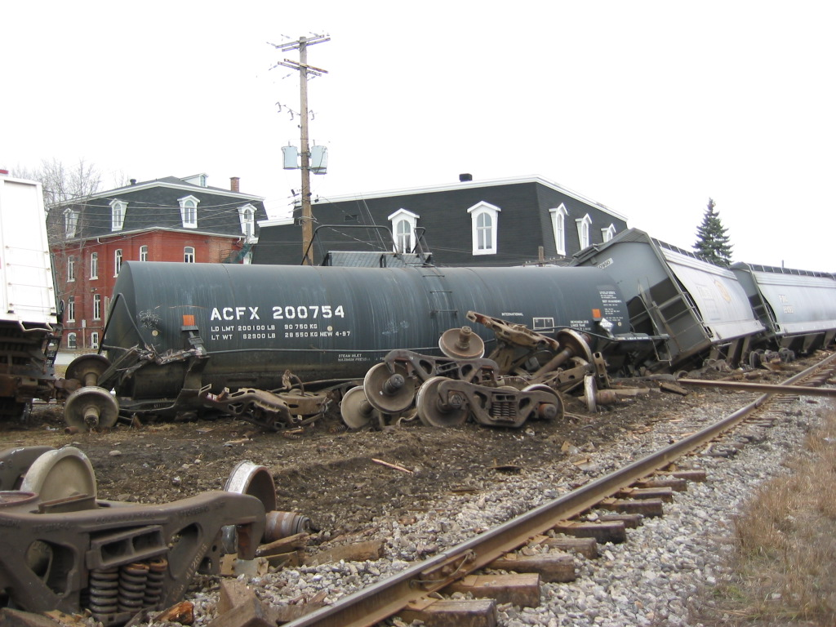
Public at Risk
Notes:
…each one has huge potential for catastrophe. One incident can require the evacuation of a town and lead to many unnecessary deaths and injuries. All virtually preventable.

Slide 10
TSB* Findings
Lack of knowledge, to public, about the hazards railways present
Motorists most often responsible for collisions
*Transportation Safety Board
Notes:
TSB Findings
Percentages may vary, but, the message is clear.
Appropriate warning appliances
Driver complacency and/or distraction
Proper sightlines…
…all play an important role.
Education, Enforcement & Engineering

Slide 11
Bilingual Program - Started in Canada in 1981
Funded by Transport Canada & The Railway Association of Canada
Partners & Stakeholders contribute in-kind services
Notes:
Program start in Canada.

Slide 12
Operation Lifesaver
Our Mandate
To eliminate the loss of life, injury and damage caused by preventable highway/railway crossing collisions and train/pedestrian incidents

Slide 13
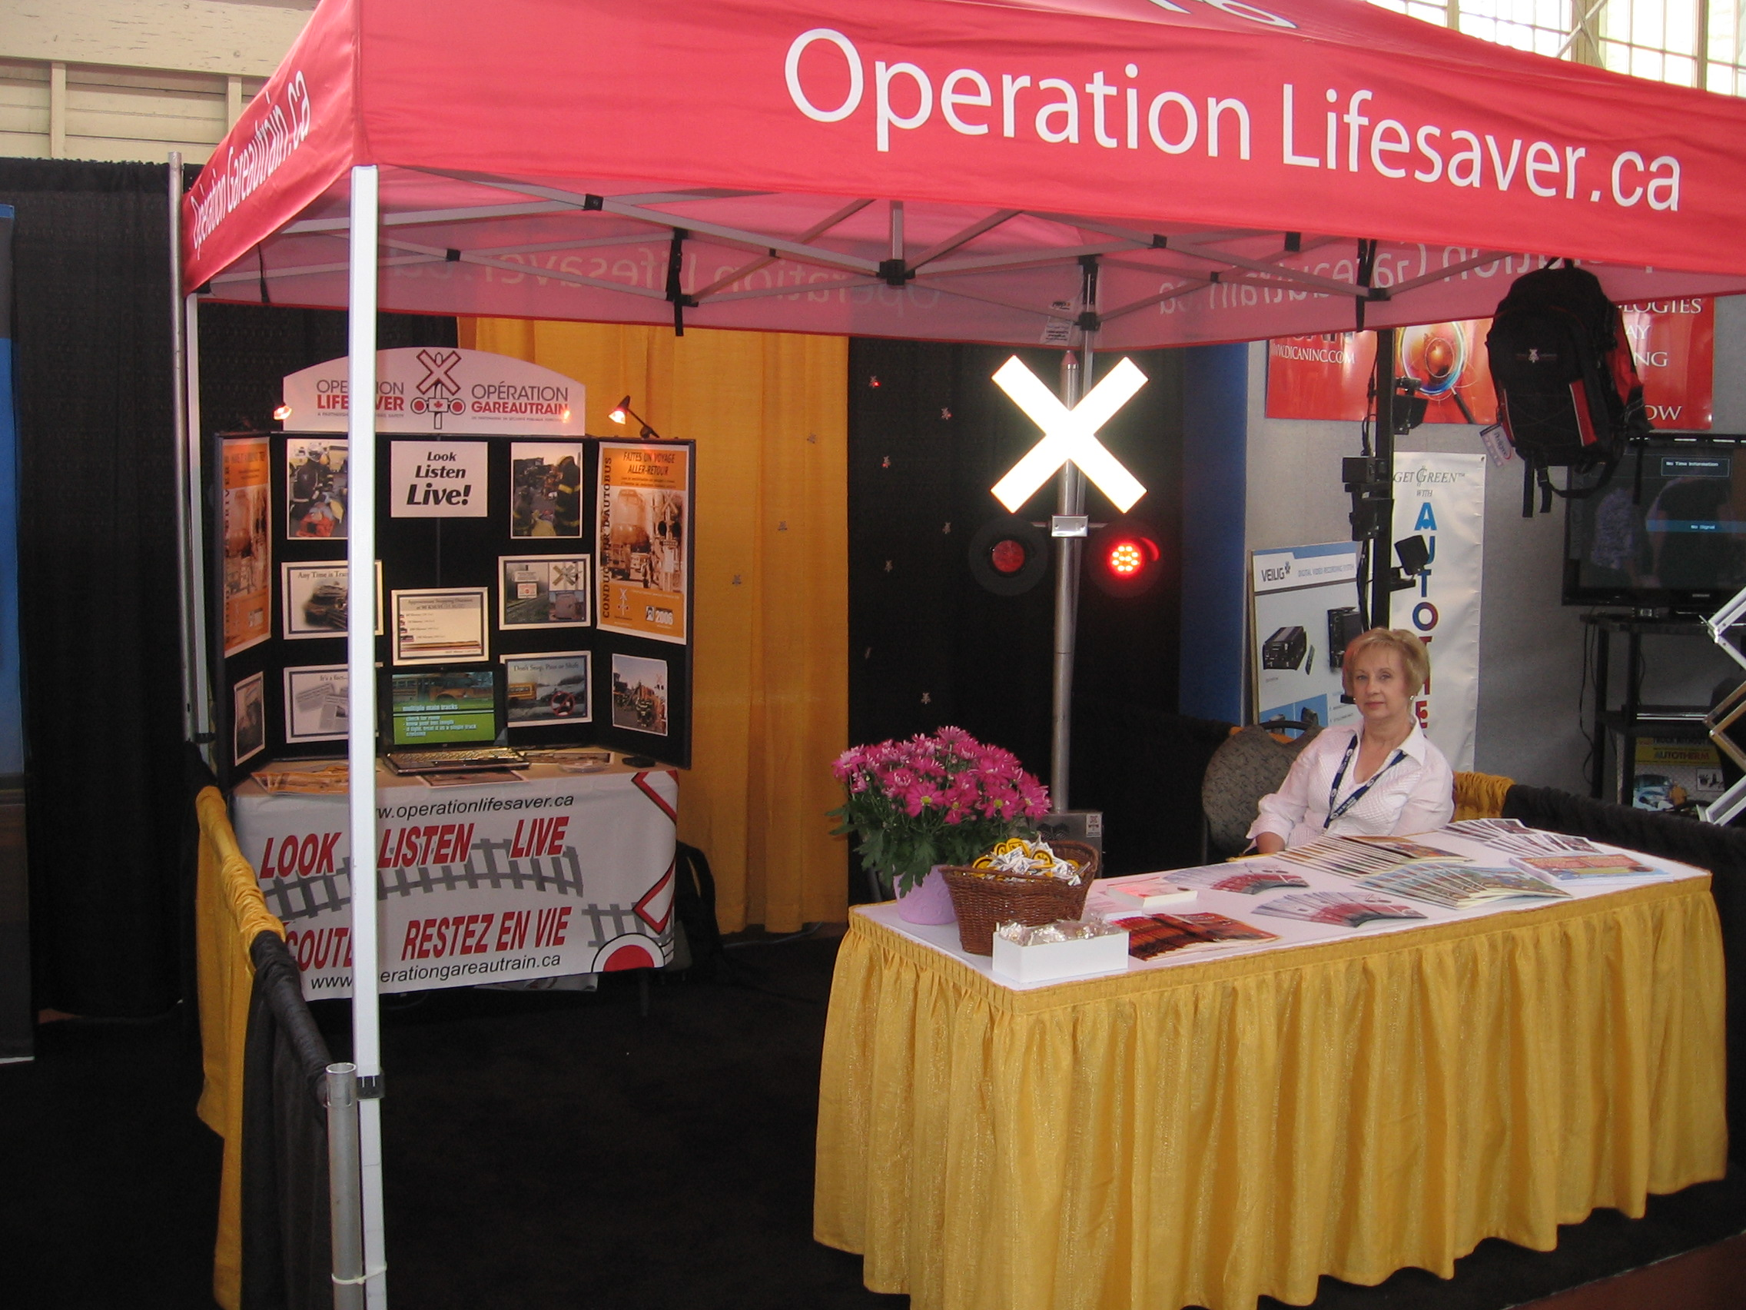
Operation Lifesaver Canada
Our Approach…
…Work in Partnership
Presentations
Activities
Displays

Slide 14
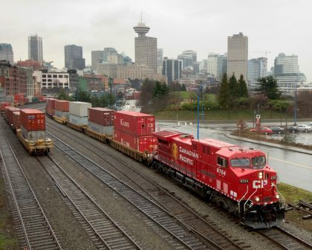
OL Partnerships
3M Canada
Canada Safety Council
Canadian Federation of Agriculture
Community Fire, Health & Protection Services
Federation of Canadian Municipalities (FCM)
Operation Lifesaver Incorporated (OLI)
Operation Lifesaver Estonia
Police (CN, CPR, OPP, RCMP, SQ & Local)
Provincial Safety Councils/Leagues
The Railway Association of Canada
Transport Canada
Unions, Public and Community groups

Slide 15
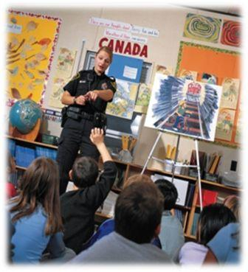
OL - Certified Presenter Program
Certified presenter program established in 1995
Presenters/Associates are trained and equipped to address a wide variety of audiences
Process ensures due diligence, consistency & methodical approach
Notes:
Our OL message is disseminated by Certified Presenters through school and corporate presentations. Much is also communicated through media interviews, displays, brochure publications and through use of on-line technology.

Slide 16
OL - Certified Presenter Program
Over 250 active certified presenters
Deliver message to more than 1.4 million Canadians each year
Notes:
Although the number of certified presenters have been dropping, we remain successful in delivering our messages and focused in reaching our audiences.

Slide 17
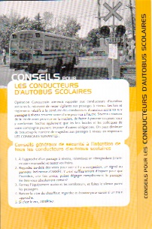
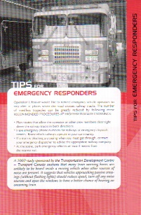
OL - Materials
OL Brochure
Public-Rail Safety Guide
Including Specific Tips for;
Professional Truck Drivers
School Bus Drivers
Emergency Responders
Commuters & Passengers
Cyclists
Farm Machinery Operators
Parents & Caregivers
ATV & Snowmobile Operators
Rail Fans
Can you Make the Grade?
Children Activity books
…and more
Notes:
How do we deliver our message? Material is available for just about every group or category and provided free of charge. Larger quantities are only available to certified presenters in order to supplement their presentations.

Slide 18
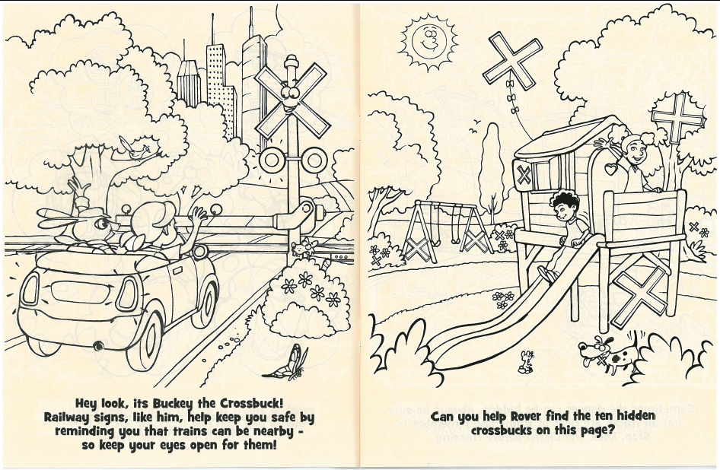
Rover’s – “Train Your Brain” activity book

Slide 19
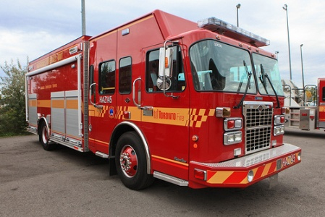
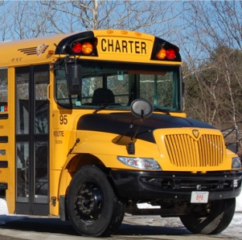
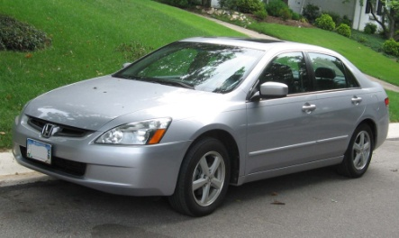
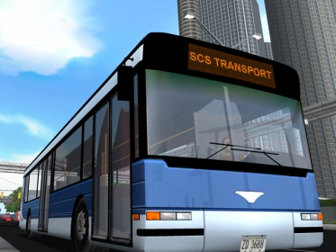
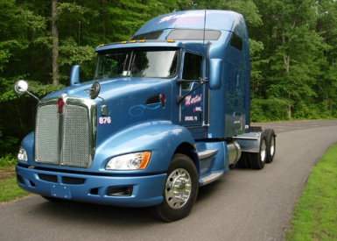
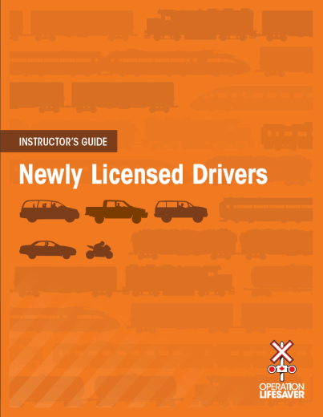
Professional Drivers Info Pkg.
Intended for Industry Trainers
Includes:
Instructor’s Guide
Student Notes
Safety Quiz
Video

Slide 20
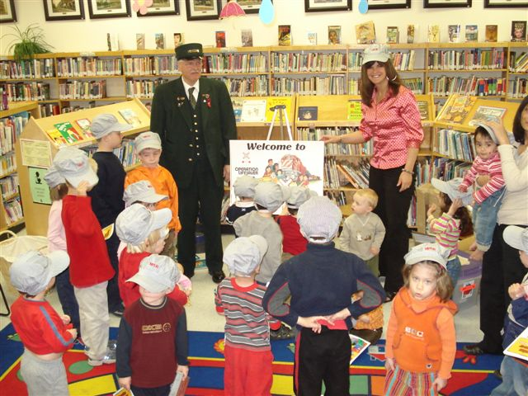
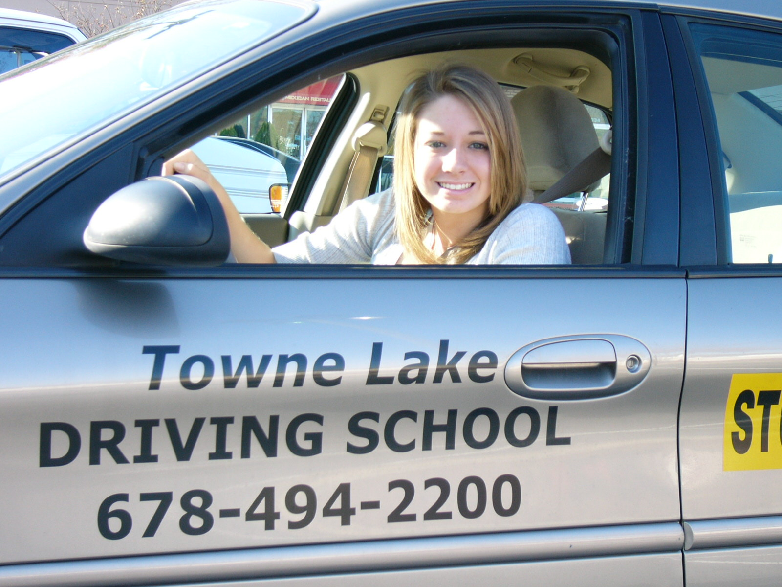
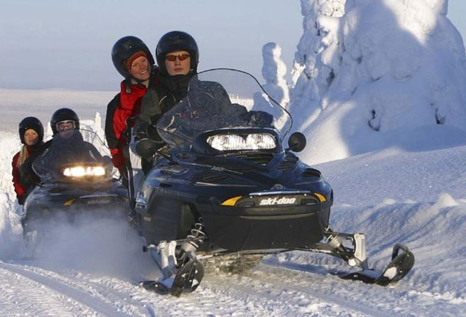
OL - Videos
Kindergarten – Grade 3
Grade 4-6
Newly licensed Drivers
Professional Truck Drivers
School Bus Drivers
Motor Coach & Transit
Emergency Responders
Snowmobile Operators
ATV Operators
…and more
Notes:
We also have videos for every age group and category and, again, provided free of charge.

Slide 21
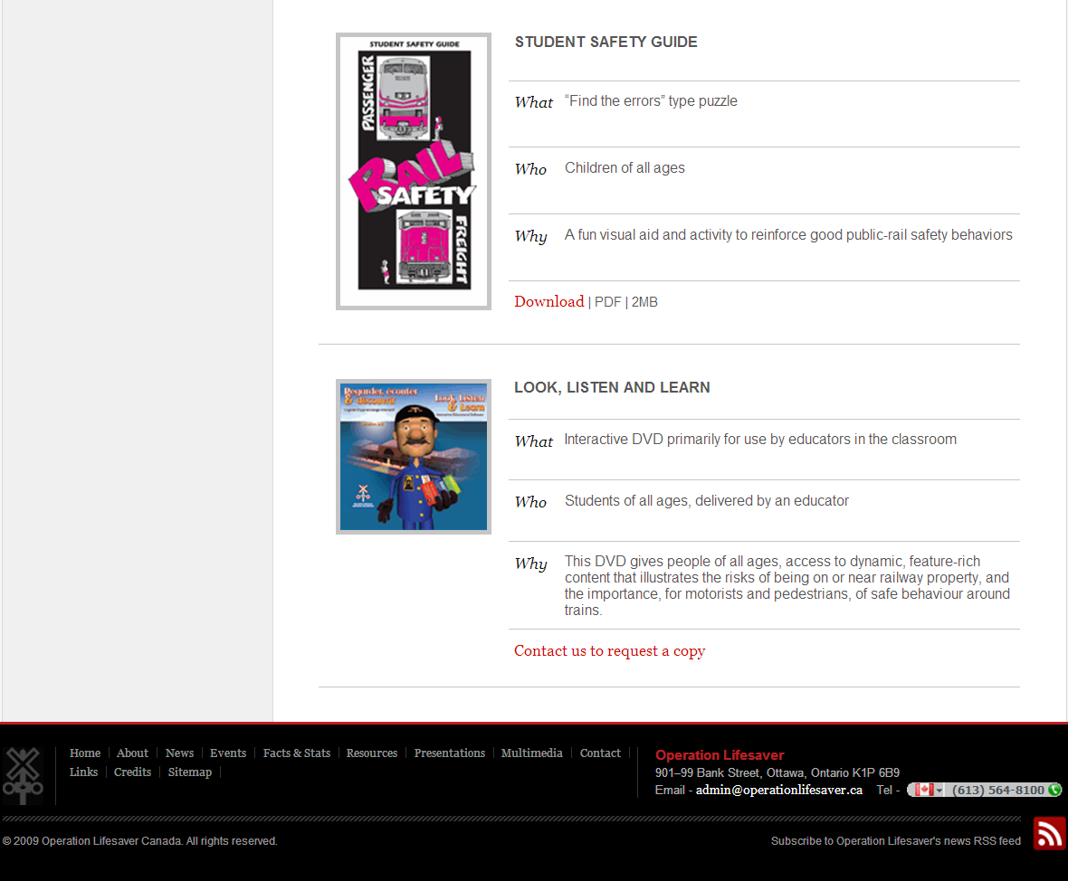
OL Web Site OperationLifesaver.ca
Improved functionality
Utilizes SEO –Search Engine Optimization
Current statistics
Includes a Presenter Section
Access to database reports
Volunteer reporting
Notes:
Using current technology - The OL web site has new revised and streamlined content with new improved features and enhanced functionality. Keywords are used in the new content to benefit from Search Engine Optimization (SEO)

Slide 22
OL Kids – www.olkids.ca
Notes:
Reaching out to the kids - The New OL Kids web site

Slide 23
OL Kids – Paint OLE
Notes:
Working in partnership, we are able to save on resources. OL has a very good working relationship with OLI and OLE. In this example, OLE has allowed OL Canada to use its wonderful OLE Paint – Digital Color Board web application tool on our OL Kids website.

Slide 24
Crossing Statistics (source TSB)
Collisions
78%
Notes:
Crossing Stats

Slide 25
Trespass Statistics (Source TSB)
Incidents
54%
Notes:
Trespassing stats

Slide 26
OL Canada - Program Evaluation
Performed by Transport Canada
Provided very favorable review
As a result…

Slide 27
Transport Canada Announcement
TC has renewed its contribution agreement for the OL program with the RAC
Includes increased funding for the new four-year agreement
Addition of four new Regional Outreach Coordinators (QC, ON, MB, BC)
Will inject additional $28M in Grade Crossing Improvement Fund in next 5 years
Notes:
TC has announced that they continue to support the OL program by providing additional funds and human resources as part of its contribution. Regional Coordinators will cover the remaining regions of Canada and similar in scope to the present position found in Atlantic Canada.

Slide 28
Strategic Plan
Focus on…
Communication
Training / Coordination
Program delivery

Slide 29
OL – Communication
Develop a Communication Plan
Create national & provincial medium
Optimize Social Media

Slide 30
Moving forward with Social Media
& Modern Technology

Slide 31
www.facebook.com/ OPLifesaver
Notes:
OL now subscribes to social media. It has its own facebook page and twitter account with regular blog postings added twice weekly.

Slide 32
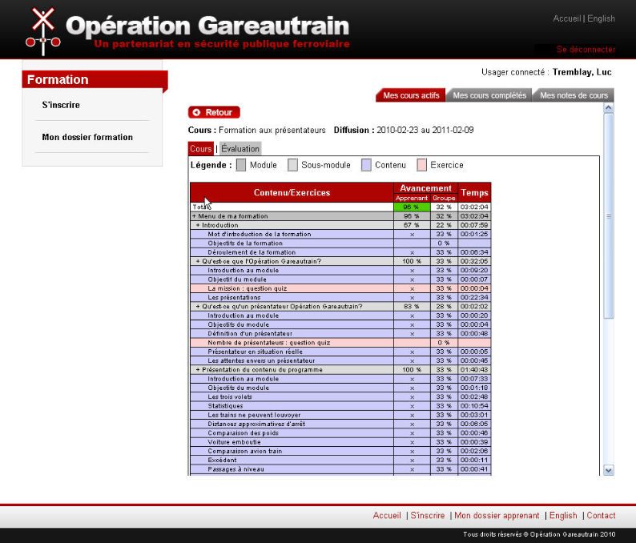
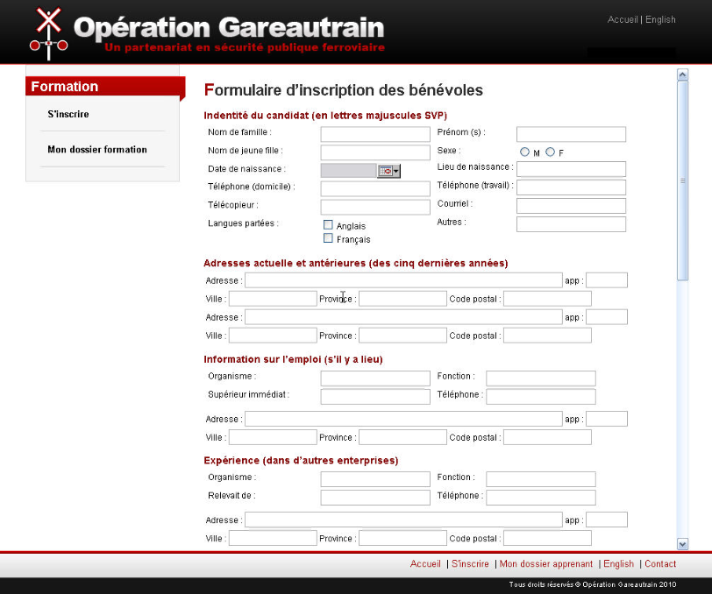
Computer Based Training for Presenter Training
On-line process for preparing applicants for certification
Clarify expectations and suitability
Applicants pace progress
Reduces time and cost
Improves process and data collection
Notes:
The Computer-Based Presenter Training module is intended to reduce the training process from two days to one. The process will ensure all prerequisites (i.e. police background check, OL program familiarity, expectations etc…) to be completed before being certified by a certified trainer and ensure that those continuing in the process do, in fact, wish to proceed and remain active. This will greatly improve the process and be cost effective.

Slide 33
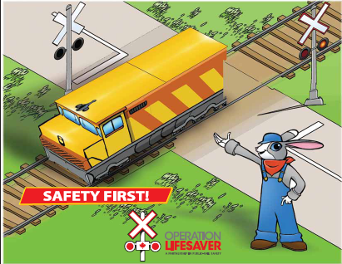
K-3 Construction cards & Evaluation
K-3 Rover Safety Play Cards & Evaluation Survey
Stand-alone handout for teachers, parents & caregivers
Notes:
Stand-alone instruction cards for K-3 children and their parents/teachers & caregivers.

Slide 34
Developing Gr. 7-8 presentation strategy
Proposal…
Implement a school project contest
Students to submit an electronic public-rail safety presentation (i.e. video, PowerPoint, Audio, etc…)
OL will post on-line for voting
Grand Prize - (TBD)
Peer to peer

Slide 35
Computer Based Training for Newly Licensed Drivers
Intended for New Drivers / Students
Modules based on the OL Newly Licensed Driver packages
Support is gained through Driving Schools and Associations
Provides consistent message
Improved data capture
www.traintodrive.net
Notes:
No need for Presenters
Newly Licensed Driver package was put on-line in form of CBT as next step. Use of the internet will provide a larger audience for our message with less human resources available while allowing the tracking of crucial data as to usage etc..
Presently working on improving data capture (stats) and reporting.

Slide 36
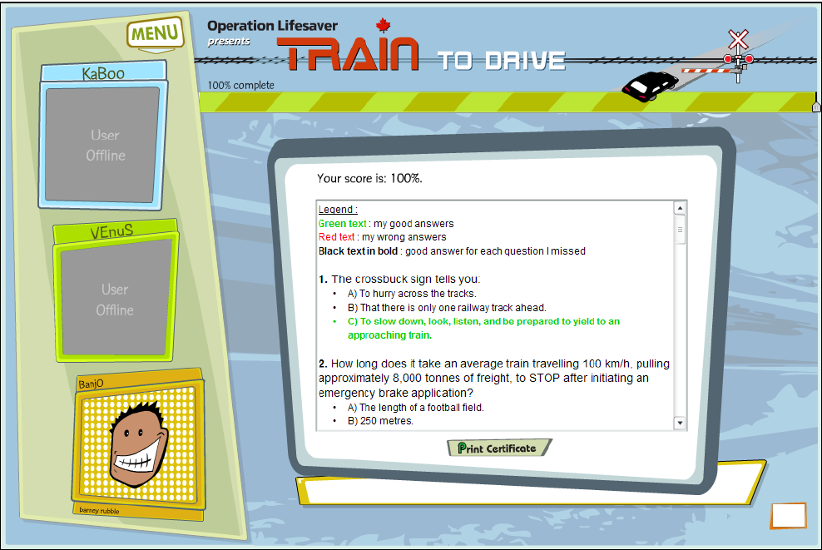
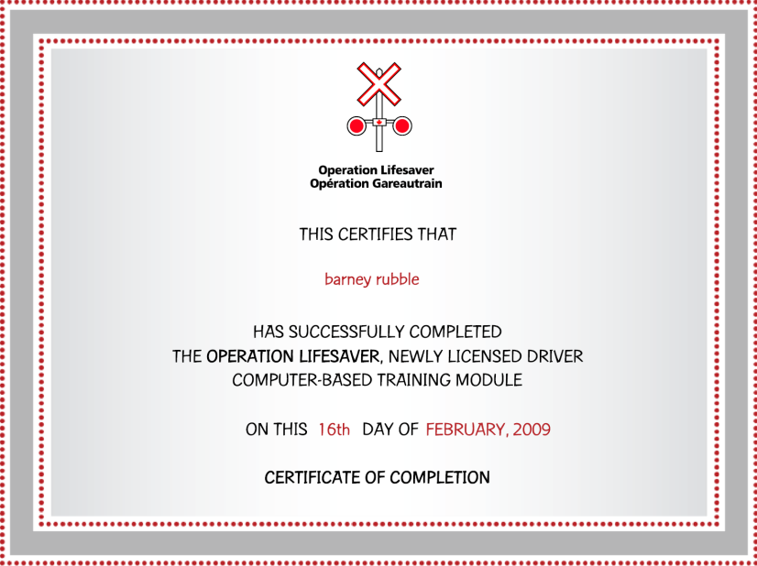
TraintoDrive.net – Overall Stats (Jan 1, 2009 – Dec 31,2010)
Registrants 16,920
Age 16-20 74.3%
Completed Training 39.0%
Obtain Certificate 89.8%
Responded to survey 2120
Liked this tool 91.9%
Learned something new 77.3%
Would recommend to others 86.5%
Notes:
The Train to Drive interactive web site is a computer-based training program intended for new and aspiring drivers. We have made good progress with driving schools (especially in Ontario) to “drive” their students to our site. In order to obtain a certificate of completion a user must achieve a minimum passing grade of 80% .
We must focus on achieving similar results from other provinces, as well.

Slide 37
OL Rail Safety Week
The 9th Annual RSW will take place May 2-8, 2011
4000 posters produced and distributed nationally
In 2010, 400 events were planned in over 175 different communities across Canada
Notes:
Lack of resources - This OL initiative began in 2003. It allows stakeholders with limited resources to concentrate their efforts during a one-week period. In 2010 there were many different organizations involved in over 400 scheduled events. Many more participated, including municipal offices, local media and community organizations.

Slide 38
OL - PowerPoint Slide Shows
Stand-alone presentations for…
Professional & Newly Licensed Drivers (5)
Recreational Vehicle Operators
Trespassing

Slide 39
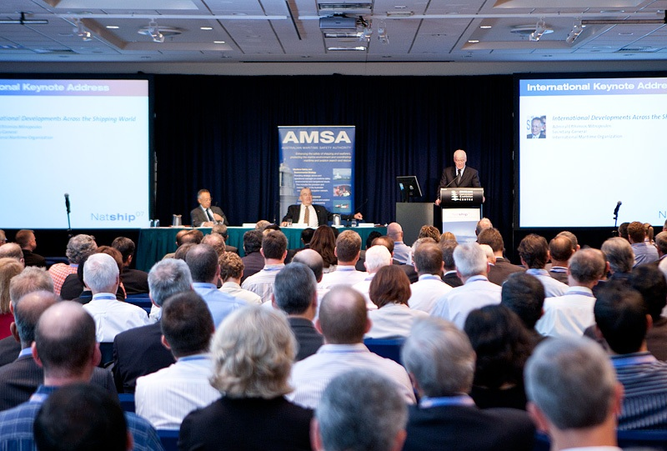
Key OL Dates for 2011
OL Rail Safety Week Initiative
May 2 - 8, 2011
ILCAD
June 9, 2011
OL Public-Rail Safety Conference
Ottawa, ON Sept 13 -14, 2011

Slide 40
OL Public-Rail Safety Conference & Showcase
2011 Event Scheduled
Sept 13-14, 2011
Sheraton Hotel
Ottawa, Ontario
Featuring 2 Keynote Speakers
With Session on :
Enforcement
Engineering
Education
Include Technology Showcase
Notes:
Keeping Current - This event allows stakeholders to be brought up-to-date with all events and initiatives surrounding public-rail safety. Invited speakers provide interesting perspectives and theories while sharing best practices from domestic and international efforts. The conference allows for an array of networking opportunities from both within and outside industry/government relations.
Recent survey taken from past attendees indicate strong support for this initiative.

Slide 41
Operation Lifesaver Canada
Thank You
Questions?
901 - 99 Bank Street, Ottawa, ON Canada, K1P 6B9
Tel: (613) 564-8094
www.operationlifesaver.ca
E-mail: dand@railcan.ca

